Slide 1
DOM events & Regex

Slide 2
Table of Contents
DOM events (listening and dispatching)
Bubbling
Concept
event.target vs this
stopping bubbles
Capturing
Regex

Slide 3
DOM events
onload | when element is fully loaded
onclick | when element is clicked
onsubmit | when element is submitted
onmousehover | when mouse is on top of element
onkeydown | when a key is pressed while element is in focus
more: https://www.w3schools.com/jsref/dom_obj_event.asp

Slide 4
Listening and dispatching events
Listen for the event
element.addEventListener(‘onSomething’, function(e){
... });
Dispatch the event
element.dispatchEvent(new Event(‘onSomething'));

Slide 5
Bubbling and capturing

Slide 6
An Example
<div onclick="alert('The handler!')"> <em>If you click on <code>EM</code>, the handler on
<code>DIV</code> runs.
</em>
</div>

Slide 7
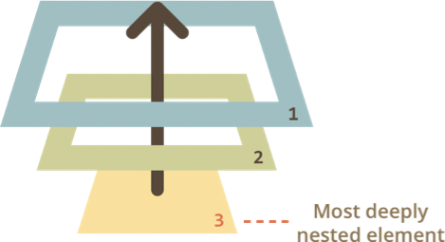
Bubbling
Concept:
When an event happens on an element, it first runs the handlers on it, then on its parent, then all the way up on other ancestors.
Check example_2.html
A click on the inner <p> first runs onclick:
a. On that <p>.
b. Then on the outer<div>
c. Then on the outer<form>
d. And so on upwards till the document object.

Slide 8
event.target vs this
event.target – is the “target” element that initiated the event, it doesn’t change through the bubbling process.
this – is the “current” element, the one that has a currently running handler on it.

Slide 9
Example
If we have a single handler form.onclick, then it can “catch” all clicks inside the form. No matter where the click happened, it bubbles up to <form> and runs the handler.
In form.onclick handler:
this (=event.currentTarget) is the <form> element, because the handler runs on it.
event.target is the concrete element inside

Slide 10
Stop bubbling
A bubbling event goes from the target element straight up.
Normally it goes upwards till <html>, and then to document object Sometimes this may cause problems!
To stop bubbling: event.stopPropagation()

Slide 11
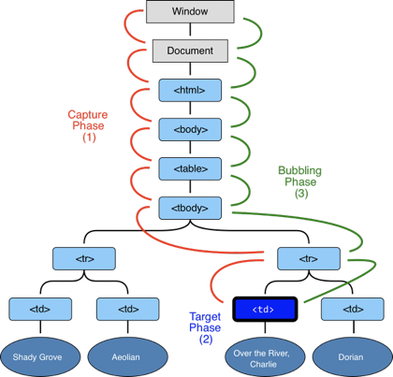
Capturing vs bubbling
Capturing phase – the event goes down to the elements
Target phase – the event reached the target element
Bubbling phase – the event goes up from the elements

Slide 12
How to capture?
To catch an event on the capturing phase, we need to set the 3rd argument of addEventListener to true.
element.addEventListener(‘onSomething’, function, true)

Slide 13
Example
The code sets click handlers on every element in the document to see which ones are working
If you click on <p>, then the sequence is:
1. capturing:
HTML → BODY → FORM → DIV → P
2. bubbling:
P → DIV → FORM → BODY → HTML

Slide 14
Regex

Slide 15
Why Regex
Regular expressions are used to perform pattern matching and “search-and-replace” functions on text.

Slide 16
How to use it in JS
var re = /pattern/;
// boolean
re.test('string’);
// null or Array [“whole match”, $1, $2, ...]
re.exec(‘string’);
//new string
re.replace(re, “string”)

Slide 17
Basic
/pattern/flags
Two forward slashes to show the beginning and end of the pattern
flags: (optional) indicate how to search (modifier).
Ex: /th/g (the g flag means "global" match - i.e. find all)

Slide 18
Syntax: Anchors
^ | Matches the beginning of input | ^a : “alice” not “banana” ^: “a line\nand break” => 2 match
$ | Matches the end of input. | a$ : “obama” not “name”
. | Matches any single character except a newline | a.b : “a0b”, “acb” not “ab”
\b | Word boundary | \bdog\b : “dog”, “dog ” not “doggy”
\B | Not word boundary | \Bdog\B : “doggy”, “adogg” not “dog”

Slide 19
Syntax: Anchors
\s | Whitespace (space, tab, newline,...) | \sc: matches “a cat” not “xcat”
\S | Not white space | \Sc: matches “cat” not “a cat”
\d | Digit | \d: matches “1” in “1abc”
\D | Not digit | \D: matches “b” in “123b”
\w | Word (alphanumeric character including _) | \w: matches “a” in “a%”
\W | Not word | \W: matches “%” in “a%”

Slide 20
Syntax: Quantifiers
* | Matches the preceding character 0 or more times | zo* : “z” and “zoo”
+ | Matches the preceding character 1 or more times | zo+ : “zoo” not “z”
? | Matches the preceding character 0 or 1 time | ca?r : only “car” and “cr”
{n} | Matches exactly n times. | o{2} : “fooood” not “bob”
{n,} | Matches at least n times | o{2,} : “fooood” not “bob”
{n,m} | Matches the preceding character n to m times | o{2,3} : “food”, “foood” not “fod”

Slide 21
Syntax: Group & Range
| | or | (z|w)o : “zo” and “wo”
(...) | Matches subexpression and remembers the match | (ab): “abc” -> 1st group match “ab”
(?:...) | Matches subexpression and do not remembers the match (the match doesn’t in array) | (ab): “abc” -> No group
(?=...) | Matches only if there is a following pattern | win(?=7): “win” in “win7” not “win95”
(?!...) | Matches only if there is not a following pattern | win(?!=7): “win8” not “win7”
[...] | Range | c[ma-c]: “cm”, “cb” not “cd” c[A-E0-5]: “cB”, “c1” not c6
[^...] | Not in range | c[^ab]: “cc” not “ca”

Slide 22
Syntax: Modifier
g | global match (find all) | /is/g : “this is” => two match
i | Case-nonsensitive | /my/i : “My” and “my”
m | Multiple line | /is/m : “this is”

Slide 23
Syntax: Replacement
$& | insert the whole regex match | "1a2b".replace(/\d+/g, "($&)") => "(1)a(2)b"
$1,... $9 | Insert the text matched by one of the first 9 capturing groups. | "abc".replace(/(a)(b)(c)/g, "$3$2$1") => "cba"
$` | Insert the part of the subject string to the left of the regex match | "abc".replace(/b/, "$`") => “aac”
$' | Insert the part of the subject string to the right of the regex match | "abc".replace(/b/, "$'") => “acc”
More info: https://www.w3schools.com/jsref/jsref_obj_regexp.asp

Slide 24
Example: Regexing Emails
Write a pattern that matches e-mail addresses. The personal information part contains the following ASCII characters:
Uppercase (A-Z) and lowercase (a-z) English letters. Digits (0-9).
Characters ! # $ % & ' * + - / = ? ^ _ ` { | } ~
Character .( period, dot or fullstop) provided that it is not the first or last
character and it will not come one after the other.

Slide 25
Solution
regexp = /^\w+([\.-]?\w+)*@\w+([\.-]?\w+)*(\.\w{2,3})+$/

